Slide 1
NEXT

Slide 2
Welcome back!
I hope you had fun trying out the
traditional games last week at the
Sun Yat Sen Nanyang Memorial Hall.
Are you excited to learn something
new today?
BACK
NEXT

Slide 3
BACK
NEXT

Slide 4
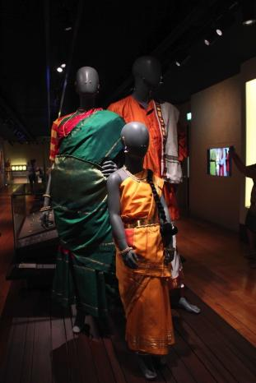
I will be visiting the
Indian Heritage Centre to learn about traditional Indian clothes
and a key festival celebrated
by many Indians in Singapore.
Collection of Indian Heritage Centre
BACK
NEXT

Slide 5
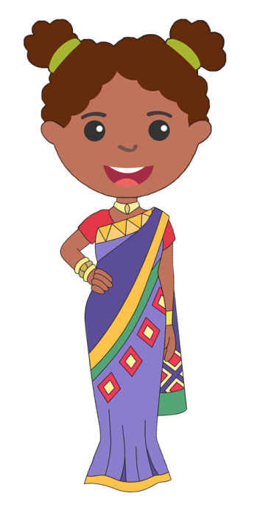
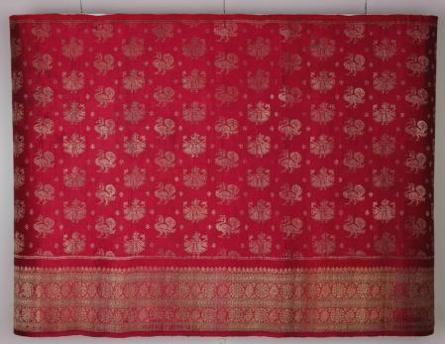
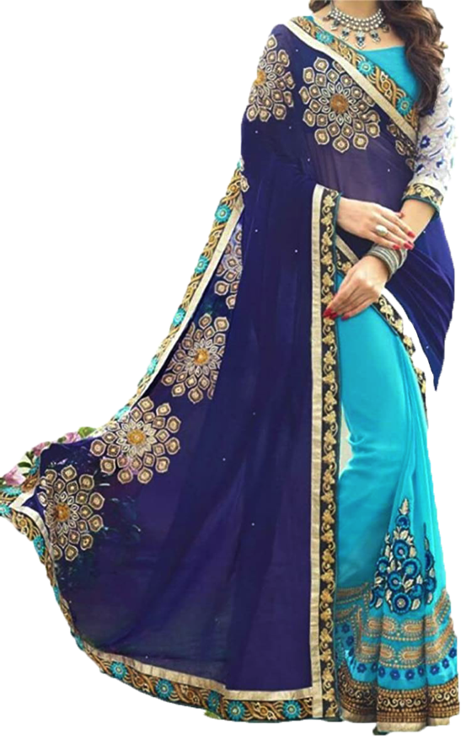
Collection of Indian Heritage Centre
The sari, worn by women, is a long piece of rectangular cloth that is wrapped around the body. Saris are commonly made of cotton or silk and come in many different colours and patterns.
BACK
NEXT

Slide 6
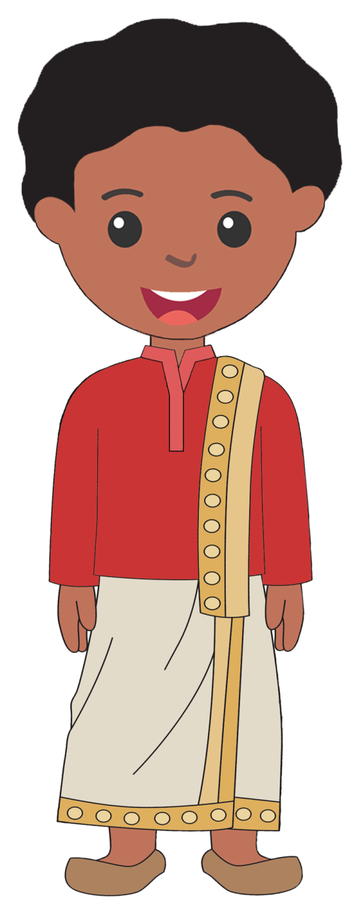
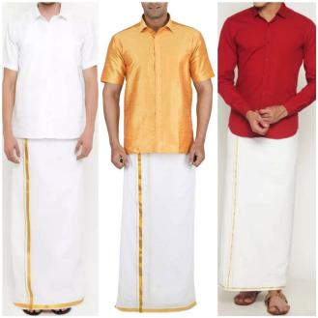
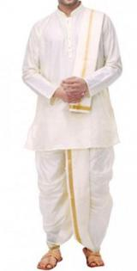
The veshti, also called a dhoti, is worn by men. It is a long white cloth wrapped around the waist and tied with a knot either in front or at the back.
BACK
NEXT

Slide 7
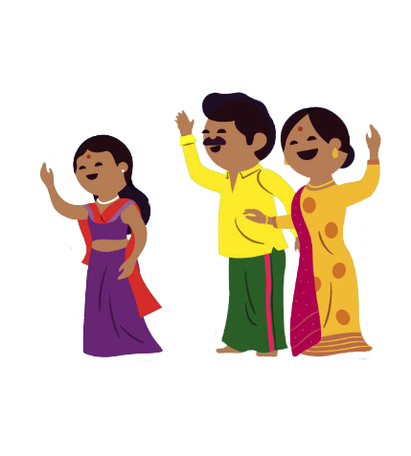
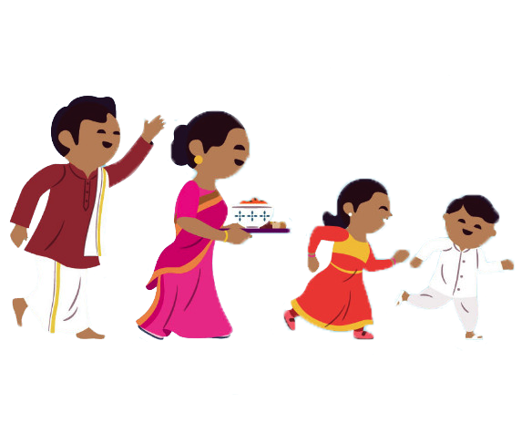
Traditional clothes are also worn during the celebration of festivals and ceremonies such as weddings.
BACK
NEXT

Slide 8
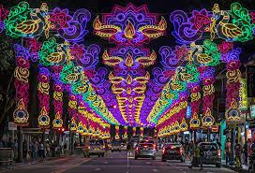
Festivals are an important part of the Indian community in Singapore.
Throughout the year, different types of festivals are celebrated by the Indian community and one key festival is Deepavali.
BACK
NEXT
Deepavali light decorations along Little India

Slide 9
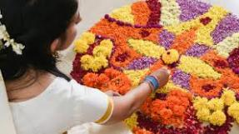
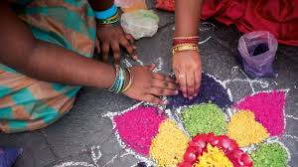
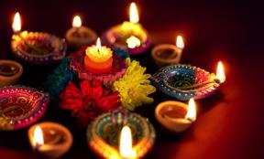
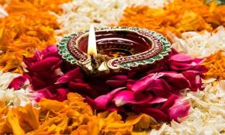
Deepavali, also known as the Festival of Lights, celebrates the victory of good over evil and light over darkness.
BACK
NEXT

Slide 10
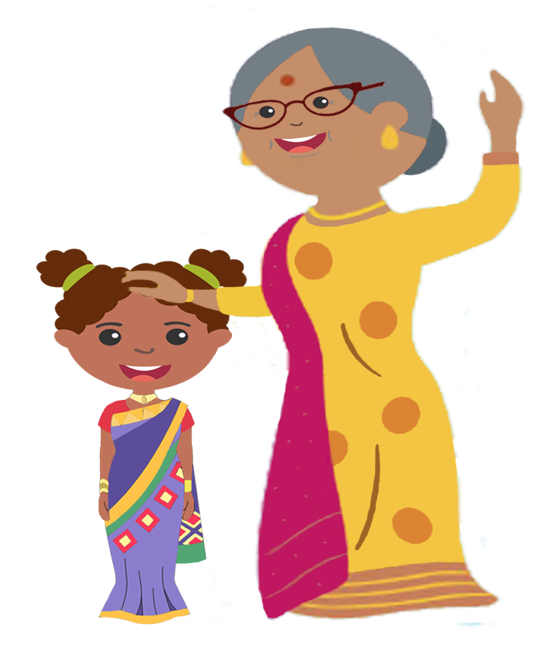
On the morning of Deepavali, most Hindus wake up early to take their oil baths before putting on their new clothes. Younger family members also receive blessings and small gifts from their elders.
BACK
NEXT

Slide 11
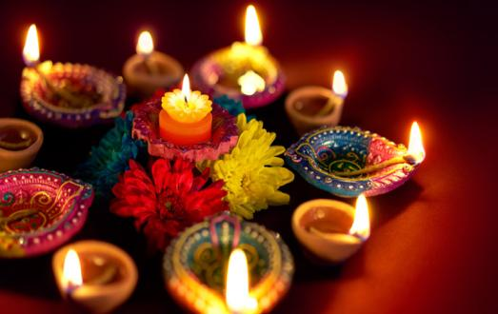
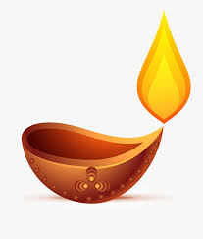
Small clay oil lamps, also called diyas, are placed at the front door to draw positive energy into the homes.
BACK
NEXT

Slide 12
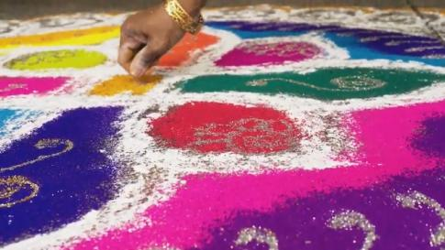
The doorways of homes are
also decorated with rangoli (or kolam).
These are patterns made from coloured rice powder or rice grains. The colourful floor decoration is said to turn away negative energy from the homes.
BACK
NEXT

Slide 13
During Deepavali, new clothes represent a new start, and a hope to become a better person. Bright colours are usually chosen as they are said to bring good luck.
BACK
NEXT

Slide 14
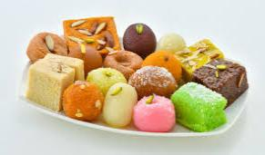
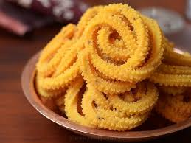
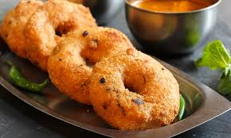
Popular food items served during Deepavali include
mithai (traditional Indian sweets),
murukku (a savoury, crunchy snack) and
vadai (a savoury fritter).
Mithai
Murukku
Vadai
BACK
NEXT

Slide 15
Now, are you ready for more games?
Click on the START button!
Start

Slide 16
Instruction:
Find the hidden words.
Start

Slide 17
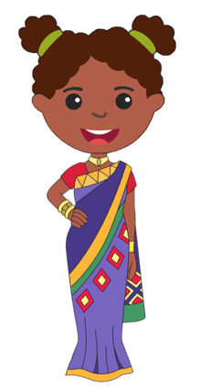
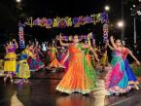
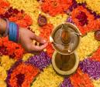
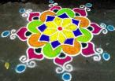
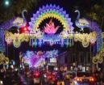
Find the hidden words.
Z
V
R
A
N
G
O
L
I
D
E
E
P
A
V
A
L
I
C
S
H
U
I
D
M
G
S
Deepavali
Sari
Oil Lamps
X
H
L
I
G
H
T
S
A
B
T
F
C
J
K
O
T
R
E
I
W
Q
R
U
S
C
I
O
I
L
L
A
M
P
S
J
Rangoli
Veshti
Lights

Slide 18
Find the hidden words.
Z
V
R
A
N
G
O
L
I
D
E
E
P
A
V
A
L
I
C
S
H
U
I
D
M
G
S
Deepavali
Sari
Oil Lamps
X
H
L
I
G
H
T
S
A
B
T
F
C
J
K
O
T
R
E
I
W
Q
R
U
S
C
I
O
I
L
L
A
M
P
S
J
Rangoli
Veshti
Lights

Slide 19
Find the hidden words.
Z
V
R
A
N
G
O
L
I
D
E
E
P
A
V
A
L
I
C
S
H
U
I
D
M
G
S
Deepavali
Sari
Oil Lamps
X
H
L
I
G
H
T
S
A
B
T
F
C
J
K
O
T
R
E
I
W
Q
R
U
S
C
I
O
I
L
L
A
M
P
S
J
Rangoli
Veshti
Lights

Slide 20
Find the hidden words.
Z
V
R
A
N
G
O
L
I
D
E
E
P
A
V
A
L
I
C
S
H
U
I
D
M
G
S
Deepavali
Sari
Oil Lamps
X
H
L
I
G
H
T
S
A
B
T
F
C
J
K
O
T
R
E
I
W
Q
R
U
S
C
I
O
I
L
L
A
M
P
S
J
Rangoli
Veshti
Lights

Slide 21
Find the hidden words.
Z
V
R
A
N
G
O
L
I
D
E
E
P
A
V
A
L
I
C
S
H
U
I
D
M
G
S
Deepavali
Sari
Oil Lamps
X
H
L
I
G
H
T
S
A
B
T
F
C
J
K
O
T
R
E
I
W
Q
R
U
S
C
I
O
I
L
L
A
M
P
S
J
Rangoli
Veshti
Lights

Slide 22
Find the hidden words.
Z
V
R
A
N
G
O
L
I
D
E
E
P
A
V
A
L
I
C
S
H
U
I
D
M
G
S
Deepavali
Sari
Oil Lamps
X
H
L
I
G
H
T
S
A
B
T
F
C
J
K
O
T
R
E
I
W
Q
R
U
S
C
I
O
I
L
L
A
M
P
S
J
Rangoli
Veshti
Lights

Slide 23
Find the hidden words.
Z
V
R
A
N
G
O
L
I
D
E
E
P
A
V
A
L
I
C
S
H
U
I
D
M
G
S
Deepavali
Sari
Oil Lamps
X
H
L
I
G
H
T
S
A
B
T
F
C
J
K
O
T
R
E
I
W
Q
R
U
S
C
I
O
I
L
L
A
M
P
S
J
Rangoli
Veshti
Lights

Slide 24
Find the hidden words.
Z
V
R
A
N
G
O
L
I
D
E
E
P
A
V
A
L
I
C
S
H
U
I
D
M
G
S
Deepavali
Sari
Oil Lamps
X
H
L
I
G
H
T
S
A
B
T
F
C
J
K
O
T
R
E
I
W
Q
R
U
S
C
I
O
I
L
L
A
M
P
S
J
Rangoli
Veshti
Lights

Slide 25
Find the hidden words.
Z
V
R
A
N
G
O
L
I
D
E
E
P
A
V
A
L
I
C
S
H
U
I
D
M
G
S
Deepavali
Sari
Oil Lamps
X
H
L
I
G
H
T
S
A
B
T
F
C
J
K
O
T
R
E
I
W
Q
R
U
S
C
I
O
I
L
L
A
M
P
S
J
Rangoli
Veshti
Lights

Slide 26
Find the hidden words.
Z
V
R
A
N
G
O
L
I
D
E
E
P
A
V
A
L
I
C
S
H
U
I
D
M
G
S
Deepavali
Sari
Oil Lamps
X
H
L
I
G
H
T
S
A
B
T
F
C
J
K
O
T
R
E
I
W
Q
R
U
S
C
I
O
I
L
L
A
M
P
S
J
Rangoli
Veshti
Lights

Slide 27
Find the hidden words.
Z
V
R
A
N
G
O
L
I
D
E
E
P
A
V
A
L
I
C
S
H
U
I
D
M
G
S
Deepavali
Sari
Oil Lamps
X
H
L
I
G
H
T
S
A
B
T
F
C
J
K
O
T
R
E
I
W
Q
R
U
S
C
I
O
I
L
L
A
M
P
S
J
Rangoli
Veshti
Lights

Slide 28
Find the hidden words.
Z
V
R
A
N
G
O
L
I
D
E
E
P
A
V
A
L
I
C
S
H
U
I
D
M
G
S
Deepavali
Sari
Oil Lamps
X
H
L
I
G
H
T
S
A
B
T
F
C
J
K
O
T
R
E
I
W
Q
R
U
S
C
I
O
I
L
L
A
M
P
S
J
Rangoli
Veshti
Lights

Slide 29
Find the hidden words.
Z
V
R
A
N
G
O
L
I
D
E
E
P
A
V
A
L
I
C
S
H
U
I
D
M
G
S
Deepavali
Sari
Oil Lamps
X
H
L
I
G
H
T
S
A
B
T
F
C
J
K
O
T
R
E
I
W
Q
R
U
S
C
I
O
I
L
L
A
M
P
S
J
Rangoli
Veshti
Lights

Slide 30
Find the hidden words.
Z
V
R
A
N
G
O
L
I
D
E
E
P
A
V
A
L
I
C
S
H
U
I
D
M
G
S
Deepavali
Sari
Oil Lamps
X
H
L
I
G
H
T
S
A
B
T
F
C
J
K
O
T
R
E
I
W
Q
R
U
S
C
I
O
I
L
L
A
M
P
S
J
Rangoli
Veshti
Lights

Slide 31
Find the hidden words.
Z
V
R
A
N
G
O
L
I
D
E
E
P
A
V
A
L
I
C
S
H
U
I
D
M
G
S
Deepavali
Sari
Oil Lamps
X
H
L
I
G
H
T
S
A
B
T
F
C
J
K
O
T
R
E
I
W
Q
R
U
S
C
I
O
I
L
L
A
M
P
S
J
Rangoli
Veshti
Lights

Slide 32
Find the hidden words.
Z
V
R
A
N
G
O
L
I
D
E
E
P
A
V
A
L
I
C
S
H
U
I
D
M
G
S
Deepavali
Sari
Oil Lamps
X
H
L
I
G
H
T
S
A
B
T
F
C
J
K
O
T
R
E
I
W
Q
R
U
S
C
I
O
I
L
L
A
M
P
S
J
Rangoli
Veshti
Lights

Slide 33
Find the hidden words.
Z
V
R
A
N
G
O
L
I
D
E
E
P
A
V
A
L
I
C
S
H
U
I
D
M
G
S
Deepavali
Sari
Oil Lamps
X
H
L
I
G
H
T
S
A
B
T
F
C
J
K
O
T
R
E
I
W
Q
R
U
S
C
I
O
I
L
L
A
M
P
S
J
Rangoli
Veshti
Lights

Slide 34
Find the hidden words.
Z
V
R
A
N
G
O
L
I
D
E
E
P
A
V
A
L
I
C
S
H
U
I
D
M
G
S
Deepavali
Sari
Oil Lamps
X
H
L
I
G
H
T
S
A
B
T
F
C
J
K
O
T
R
E
I
W
Q
R
U
S
C
I
O
I
L
L
A
M
P
S
J
Rangoli
Veshti
Lights

Slide 35
Find the hidden words.
Z
V
R
A
N
G
O
L
I
D
E
E
P
A
V
A
L
I
C
S
H
U
I
D
M
G
S
Deepavali
Sari
Oil Lamps
X
H
L
I
G
H
T
S
A
B
T
F
C
J
K
O
T
R
E
I
W
Q
R
U
S
C
I
O
I
L
L
A
M
P
S
J
Rangoli
Veshti
Lights

Slide 36
Find the hidden words.
Z
V
R
A
N
G
O
L
I
D
E
E
P
A
V
A
L
I
C
S
H
U
I
D
M
G
S
Deepavali
Sari
Oil Lamps
X
H
L
I
G
H
T
S
A
B
T
F
C
J
K
O
T
R
E
I
W
Q
R
U
S
C
I
O
I
L
L
A
M
P
S
J
Rangoli
Veshti
Lights

Slide 37
Find the hidden words.
Z
V
R
A
N
G
O
L
I
D
E
E
P
A
V
A
L
I
C
S
H
U
I
D
M
G
S
Deepavali
Sari
Oil Lamps
X
H
L
I
G
H
T
S
A
B
T
F
C
J
K
O
T
R
E
I
W
Q
R
U
S
C
I
O
I
L
L
A
M
P
S
J
Rangoli
Veshti
Lights

Slide 38
Find the hidden words.
Z
V
R
A
N
G
O
L
I
D
E
E
P
A
V
A
L
I
C
S
H
U
I
D
M
G
S
Deepavali
Sari
Oil Lamps
X
H
L
I
G
H
T
S
A
B
T
F
C
J
K
O
T
R
E
I
W
Q
R
U
S
C
I
O
I
L
L
A
M
P
S
J
Rangoli
Veshti
Lights

Slide 39
Find the hidden words.
Z
V
R
A
N
G
O
L
I
D
E
E
P
A
V
A
L
I
C
S
H
U
I
D
M
G
S
Deepavali
Sari
Oil Lamps
X
H
L
I
G
H
T
S
A
B
T
F
C
J
K
O
T
R
E
I
W
Q
R
U
S
C
I
O
I
L
L
A
M
P
S
J
Rangoli
Veshti
Lights

Slide 40
Find the hidden words.
Z
V
R
A
N
G
O
L
I
D
E
E
P
A
V
A
L
I
C
S
H
U
I
D
M
G
S
Deepavali
Sari
Oil Lamps
X
H
L
I
G
H
T
S
A
B
T
F
C
J
K
O
T
R
E
I
W
Q
R
U
S
C
I
O
I
L
L
A
M
P
S
J
Rangoli
Veshti
Lights

Slide 41
Find the hidden words.
Z
V
R
A
N
G
O
L
I
D
E
E
P
A
V
A
L
I
C
S
H
U
I
D
M
G
S
Deepavali
Sari
Oil Lamps
X
H
L
I
G
H
T
S
A
B
T
F
C
J
K
O
T
R
E
I
W
Q
R
U
S
C
I
O
I
L
L
A
M
P
S
J
Rangoli
Veshti
Lights

Slide 42
Find the hidden words.
Z
V
R
A
N
G
O
L
I
D
E
E
P
A
V
A
L
I
C
S
H
U
I
D
M
G
S
Deepavali
Sari
Oil Lamps
X
H
L
I
G
H
T
S
A
B
T
F
C
J
K
O
T
R
E
I
W
Q
R
U
S
C
I
O
I
L
L
A
M
P
S
J
Rangoli
Veshti
Lights

Slide 43
Find the hidden words.
Z
V
R
A
N
G
O
L
I
D
E
E
P
A
V
A
L
I
C
S
H
U
I
D
M
G
S
Deepavali
Sari
Oil Lamps
X
H
L
I
G
H
T
S
A
B
T
F
C
J
K
O
T
R
E
I
W
Q
R
U
S
C
I
O
I
L
L
A
M
P
S
J
Rangoli
Veshti
Lights

Slide 44
Find the hidden words.
Z
V
R
A
N
G
O
L
I
D
E
E
P
A
V
A
L
I
C
S
H
U
I
D
M
G
S
Deepavali
Sari
Oil Lamps
X
H
L
I
G
H
T
S
A
B
T
F
C
J
K
O
T
R
E
I
W
Q
R
U
S
C
I
O
I
L
L
A
M
P
S
J
Rangoli
Veshti
Lights

Slide 45
Find the hidden words.
Z
V
R
A
N
G
O
L
I
D
E
E
P
A
V
A
L
I
C
S
H
U
I
D
M
G
S
Deepavali
Sari
Oil Lamps
X
H
L
I
G
H
T
S
A
B
T
F
C
J
K
O
T
R
E
I
W
Q
R
U
S
C
I
O
I
L
L
A
M
P
S
J
Rangoli
Veshti
Lights

Slide 46
Find the hidden words.
Z
V
R
A
N
G
O
L
I
D
E
E
P
A
V
A
L
I
C
S
H
U
I
D
M
G
S
Deepavali
Sari
Oil Lamps
X
H
L
I
G
H
T
S
A
B
T
F
C
J
K
O
T
R
E
I
W
Q
R
U
S
C
I
O
I
L
L
A
M
P
S
J
Rangoli
Veshti
Lights

Slide 47
Find the hidden words.
Z
V
R
A
N
G
O
L
I
D
E
E
P
A
V
A
L
I
C
S
H
U
I
D
M
G
S
Deepavali
Sari
Oil Lamps
X
H
L
I
G
H
T
S
A
B
T
F
C
J
K
O
T
R
E
I
W
Q
R
U
S
C
I
O
I
L
L
A
M
P
S
J
Rangoli
Veshti
Lights

Slide 48
Find the hidden words.
Z
V
R
A
N
G
O
L
I
D
E
E
P
A
V
A
L
I
C
S
H
U
I
D
M
G
S
Deepavali
Sari
Oil Lamps
X
H
L
I
G
H
T
S
A
B
T
F
C
J
K
O
T
R
E
I
W
Q
R
U
S
C
I
O
I
L
L
A
M
P
S
J
Rangoli
Veshti
Lights

Slide 49
Find the hidden words.
Z
V
R
A
N
G
O
L
I
D
E
E
P
A
V
A
L
I
C
S
H
U
I
D
M
G
S
Deepavali
Sari
Oil Lamps
X
H
L
I
G
H
T
S
A
B
T
F
C
J
K
O
T
R
E
I
W
Q
R
U
S
C
I
O
I
L
L
A
M
P
S
J
Rangoli
Veshti
Lights

Slide 50
Find the hidden words.
Z
V
R
A
N
G
O
L
I
D
E
E
P
A
V
A
L
I
C
S
H
U
I
D
M
G
S
Deepavali
Sari
Oil Lamps
X
H
L
I
G
H
T
S
A
B
T
F
C
J
K
O
T
R
E
I
W
Q
R
U
S
C
I
O
I
L
L
A
M
P
S
J
Rangoli
Veshti
Lights

Slide 51
Find the hidden words.
Z
V
R
A
N
G
O
L
I
D
E
E
P
A
V
A
L
I
C
S
H
U
I
D
M
G
S
Deepavali
Sari
Oil Lamps
X
H
L
I
G
H
T
S
A
B
T
F
C
J
K
O
T
R
E
I
W
Q
R
U
S
C
I
O
I
L
L
A
M
P
S
J
Rangoli
Veshti
Lights

Slide 52
Find the hidden words.
Z
V
R
A
N
G
O
L
I
D
E
E
P
A
V
A
L
I
C
S
H
U
I
D
M
G
S
Deepavali
Sari
Oil Lamps
X
H
L
I
G
H
T
S
A
B
T
F
C
J
K
O
T
R
E
I
W
Q
R
U
S
C
I
O
I
L
L
A
M
P
S
J
Rangoli
Veshti
Lights

Slide 53
Find the hidden words.
Z
V
R
A
N
G
O
L
I
D
E
E
P
A
V
A
L
I
C
S
H
U
I
D
M
G
S
Deepavali
Sari
Oil Lamps
X
H
L
I
G
H
T
S
A
B
T
F
C
J
K
O
T
R
E
I
W
Q
R
U
S
C
I
O
I
L
L
A
M
P
S
J
Rangoli
Veshti
Lights

Slide 54
Find the hidden words.
Z
V
R
A
N
G
O
L
I
D
E
E
P
A
V
A
L
I
C
S
H
U
I
D
M
G
S
Deepavali
Sari
Oil Lamps
X
H
L
I
G
H
T
S
A
B
T
F
C
J
K
O
T
R
E
I
W
Q
R
U
S
C
I
O
I
L
L
A
M
P
S
J
Rangoli
Veshti
Lights

Slide 55
Find the hidden words.
Z
V
R
A
N
G
O
L
I
D
E
E
P
A
V
A
L
I
C
S
H
U
I
D
M
G
S
Deepavali
Sari
Oil Lamps
X
H
L
I
G
H
T
S
A
B
T
F
C
J
K
O
T
R
E
I
W
Q
R
U
S
C
I
O
I
L
L
A
M
P
S
J
Rangoli
Veshti
Lights

Slide 56
Find the hidden words.
Z
V
R
A
N
G
O
L
I
D
E
E
P
A
V
A
L
I
C
S
H
U
I
D
M
G
S
Deepavali
Sari
Oil Lamps
X
H
L
I
G
H
T
S
A
B
T
F
C
J
K
O
T
R
E
I
W
Q
R
U
S
C
I
O
I
L
L
A
M
P
S
J
Rangoli
Veshti
Lights

Slide 57
Find the hidden words.
Z
V
R
A
N
G
O
L
I
D
E
E
P
A
V
A
L
I
C
S
H
U
I
D
M
G
S
Deepavali
Sari
Oil Lamps
X
H
L
I
G
H
T
S
A
B
T
F
C
J
K
O
T
R
E
I
W
Q
R
U
S
C
I
O
I
L
L
A
M
P
S
J
Rangoli
Veshti
Lights

Slide 58
Find the hidden words.
Z
V
R
A
N
G
O
L
I
D
E
E
P
A
V
A
L
I
C
S
H
U
I
D
M
G
S
Deepavali
Sari
Oil Lamps
X
H
L
I
G
H
T
S
A
B
T
F
C
J
K
O
T
R
E
I
W
Q
R
U
S
C
I
O
I
L
L
A
M
P
S
J
Rangoli
Veshti
Lights

Slide 59
Find the hidden words.
Z
V
R
A
N
G
O
L
I
D
E
E
P
A
V
A
L
I
C
S
H
U
I
D
M
G
S
Deepavali
Sari
Oil Lamps
X
H
L
I
G
H
T
S
A
B
T
F
C
J
K
O
T
R
E
I
W
Q
R
U
S
C
I
O
I
L
L
A
M
P
S
J
Rangoli
Veshti
Lights

Slide 60
Find the hidden words.
Z
V
R
A
N
G
O
L
I
D
E
E
P
A
V
A
L
I
C
S
H
U
I
D
M
G
S
Deepavali
Sari
Oil Lamps
X
H
L
I
G
H
T
S
A
B
T
F
C
J
K
O
T
R
E
I
W
Q
R
U
S
C
I
O
I
L
L
A
M
P
S
J
Rangoli
Veshti
Lights

Slide 61
Find the hidden words.
Z
V
R
A
N
G
O
L
I
D
E
E
P
A
V
A
L
I
C
S
H
U
I
D
M
G
S
Deepavali
Sari
Oil Lamps
X
H
L
I
G
H
T
S
A
B
T
F
C
J
K
O
T
R
E
I
W
Q
R
U
S
C
I
O
I
L
L
A
M
P
S
J
Rangoli
Veshti
Lights

Slide 62
Find the hidden words.
Z
V
R
A
N
G
O
L
I
D
E
E
P
A
V
A
L
I
C
S
H
U
I
D
M
G
S
Deepavali
Sari
Oil Lamps
X
H
L
I
G
H
T
S
A
B
T
F
C
J
K
O
T
R
E
I
W
Q
R
U
S
C
I
O
I
L
L
A
M
P
S
J
Rangoli
Veshti
Lights

Slide 63
Find the hidden words.
Z
V
R
A
N
G
O
L
I
D
E
E
P
A
V
A
L
I
C
S
H
U
I
D
M
G
S
Deepavali
Sari
Oil Lamps
X
H
L
I
G
H
T
S
A
B
T
F
C
J
K
O
T
R
E
I
W
Q
R
U
S
C
I
O
I
L
L
A
M
P
S
J
Rangoli
Veshti
Lights

Slide 64
Find the hidden words.
Z
V
R
A
N
G
O
L
I
D
E
E
P
A
V
A
L
I
C
S
H
U
I
D
M
G
S
Deepavali
Sari
Oil Lamps
X
H
L
I
G
H
T
S
A
B
T
F
C
J
K
O
T
R
E
I
W
Q
R
U
S
C
I
O
I
L
L
A
M
P
S
J
Rangoli
Veshti
Lights

Slide 65
Find the hidden words.
Z
V
R
A
N
G
O
L
I
D
E
E
P
A
V
A
L
I
C
S
H
U
I
D
M
G
S
Deepavali
Sari
Oil Lamps
X
H
L
I
G
H
T
S
A
B
T
F
C
J
K
O
T
R
E
I
W
Q
R
U
S
C
I
O
I
L
L
A
M
P
S
J
Rangoli
Veshti
Lights

Slide 66
Find the hidden words.
Z
V
R
A
N
G
O
L
I
D
E
E
P
A
V
A
L
I
C
S
H
U
I
D
M
G
S
Deepavali
Sari
Oil Lamps
X
H
L
I
G
H
T
S
A
B
T
F
C
J
K
O
T
R
E
I
W
Q
R
U
S
C
I
O
I
L
L
A
M
P
S
J
Rangoli
Veshti
Lights

Slide 67
Find the hidden words.
Z
V
R
A
N
G
O
L
I
D
E
E
P
A
V
A
L
I
C
S
H
U
I
D
M
G
S
Deepavali
Sari
Oil Lamps
X
H
L
I
G
H
T
S
A
B
T
F
C
J
K
O
T
R
E
I
W
Q
R
U
S
C
I
O
I
L
L
A
M
P
S
J
Rangoli
Veshti
Lights

Slide 68
Find the hidden words.
Z
V
R
A
N
G
O
L
I
D
E
E
P
A
V
A
L
I
C
S
H
U
I
D
M
G
S
Deepavali
Sari
Oil Lamps
X
H
L
I
G
H
T
S
A
B
T
F
C
J
K
O
T
R
E
I
W
Q
R
U
S
C
I
O
I
L
L
A
M
P
S
J
Rangoli
Veshti
Lights

Slide 69
Find the hidden words.
Z
V
R
A
N
G
O
L
I
D
E
E
P
A
V
A
L
I
C
S
H
U
I
D
M
G
S
Deepavali
Sari
Oil Lamps
X
H
L
I
G
H
T
S
A
B
T
F
C
J
K
O
T
R
E
I
W
Q
R
U
S
C
I
O
I
L
L
A
M
P
S
J
Rangoli
Veshti
Lights

Slide 70
Find the hidden words.
Z
V
R
A
N
G
O
L
I
D
E
E
P
A
V
A
L
I
C
S
H
U
I
D
M
G
S
Deepavali
Sari
Oil Lamps
X
H
L
I
G
H
T
S
A
B
T
F
C
J
K
O
T
R
E
I
W
Q
R
U
S
C
I
O
I
L
L
A
M
P
S
J
Rangoli
Veshti
Lights

Slide 71
Find the hidden words.
Z
V
R
A
N
G
O
L
I
D
E
E
P
A
V
A
L
I
C
S
H
U
I
D
M
G
S
Deepavali
Sari
Oil Lamps
X
H
L
I
G
H
T
S
A
B
T
F
C
J
K
O
T
R
E
I
W
Q
R
U
S
C
I
O
I
L
L
A
M
P
S
J
Rangoli
Veshti
Lights

Slide 72
Find the hidden words.
Z
V
R
A
N
G
O
L
I
D
E
E
P
A
V
A
L
I
C
S
H
U
I
D
M
G
S
Deepavali
Sari
Oil Lamps
X
H
L
I
G
H
T
S
A
B
T
F
C
J
K
O
T
R
E
I
W
Q
R
U
S
C
I
O
I
L
L
A
M
P
S
J
Rangoli
Veshti
Lights

Slide 73
Find the hidden words.
Z
V
R
A
N
G
O
L
I
D
E
E
P
A
V
A
L
I
C
S
H
U
I
D
M
G
S
Deepavali
Sari
Oil Lamps
X
H
L
I
G
H
T
S
A
B
T
F
C
J
K
O
T
R
E
I
W
Q
R
U
S
C
I
O
I
L
L
A
M
P
S
J
Rangoli
Veshti
Lights

Slide 74
Find the hidden words.
Z
V
R
A
N
G
O
L
I
D
E
E
P
A
V
A
L
I
C
S
H
U
I
D
M
G
S
Deepavali
Sari
Oil Lamps
X
H
L
I
G
H
T
S
A
B
T
F
C
J
K
O
T
R
E
I
W
Q
R
U
S
C
I
O
I
L
L
A
M
P
S
J
Rangoli
Veshti
Lights

Slide 75
Find the hidden words.
Z
V
R
A
N
G
O
L
I
D
E
E
P
A
V
A
L
I
C
S
H
U
I
D
M
G
S
Deepavali
Sari
Oil Lamps
X
H
L
I
G
H
T
S
A
B
T
F
C
J
K
O
T
R
E
I
W
Q
R
U
S
C
I
O
I
L
L
A
M
P
S
J
Rangoli
Veshti
Lights

Slide 76
Find the hidden words.
Z
V
R
A
N
G
O
L
I
D
E
E
P
A
V
A
L
I
S
U
M
G
C
H
I
D
G
S
Deepavali
Sari
Oil Lamps
X
H
L
I
G
H
T
S
A
B
T
F
C
J
K
O
T
R
E
I
W
Q
R
U
S
C
I
O
I
L
L
A
M
P
S
J
Rangoli
Veshti
Lights

Slide 77
Find the hidden words.
Z
V
R
A
N
G
O
L
I
D
E
E
P
A
V
A
L
I
C
S
H
U
I
D
M
G
S
Deepavali
Sari
Oil Lamps
X
H
L
I
G
H
T
S
A
B
T
F
C
J
K
O
T
R
E
I
W
Q
R
U
S
C
I
O
I
L
L
A
M
P
S
J
Rangoli
Veshti
Lights

Slide 78
Find the hidden words.
Z
V
R
A
N
G
O
L
I
D
E
E
P
A
V
A
L
I
C
S
H
U
I
D
M
G
S
Deepavali
Sari
Oil Lamps
X
H
L
I
G
H
T
S
A
B
T
F
C
J
K
O
T
R
E
I
W
Q
R
U
S
C
I
O
I
L
L
A
M
P
S
J
Rangoli
Veshti
Lights

Slide 79
Find the hidden words.
Z
V
R
A
N
G
O
L
I
D
E
E
P
A
V
A
L
I
C
S
H
U
I
D
M
G
S
Deepavali
Sari
Oil Lamps
X
H
L
I
G
H
T
S
A
B
T
F
C
J
K
O
T
R
E
I
W
Q
R
U
S
C
I
O
I
L
L
A
M
P
S
J
Rangoli
Veshti
Lights

Slide 80
CORRECT
Z
V
R
A
N
G
O
L
I
D
E
E
P
A
V
A
L
I
C
S
H
U
I
D
M
G
S
X
H
L
I
G
H
T
S
A
B
T
F
C
J
K
O
T
R
E
I
W
Q
R
U
S
C
I
O
I
L
L
A
M
P
S
J
Next

Slide 81
Instruction:
Find 5 items that are not part of Deepavali celebrations.
Start

Slide 82
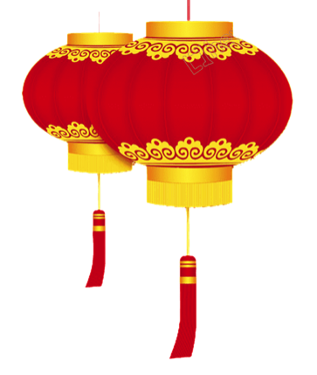
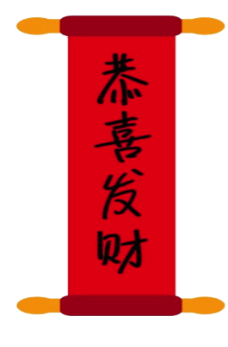
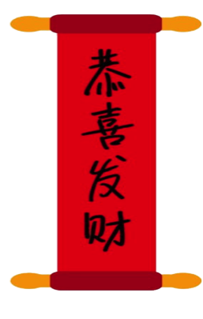
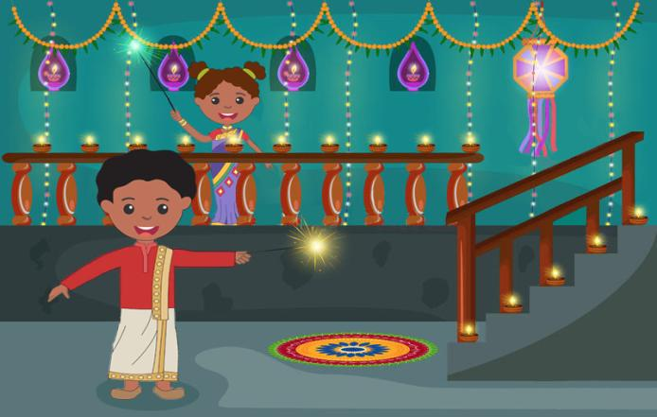
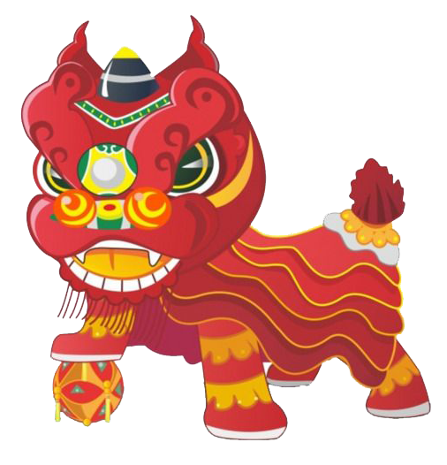
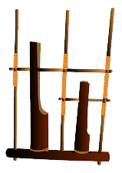
Which objects are not part of Deepavali celebrations?

Slide 83
Which objects are not part of Deepavali celebrations?

Slide 84
Which objects are not part of Deepavali celebrations?

Slide 85
Which objects are not part of Deepavali celebrations?

Slide 86
Which objects are not part of Deepavali celebrations?

Slide 87
Which objects are not part of Deepavali celebrations?

Slide 88
Which objects are not part of Deepavali celebrations?

Slide 89
Which objects are not part of Deepavali celebrations?

Slide 90
Which objects are not part of Deepavali celebrations?

Slide 91
Which objects are not part of Deepavali celebrations?

Slide 92
Which objects are not part of Deepavali celebrations?

Slide 93
Which objects are not part of Deepavali celebrations?

Slide 94
Which objects are not part of Deepavali celebrations?

Slide 95
Which objects are not part of Deepavali celebrations?

Slide 96
Which objects are not part of Deepavali celebrations?

Slide 97
Which objects are not part of Deepavali celebrations?

Slide 98
Which objects are not part of Deepavali celebrations?

Slide 99
Which objects are not part of Deepavali celebrations?

Slide 100
Which objects are not part of Deepavali celebrations?

Slide 101
Which objects are not part of Deepavali celebrations?

Slide 102
Which objects are not part of Deepavali celebrations?

Slide 103
Which objects are not part of Deepavali celebrations?

Slide 104
Which objects are not part of Deepavali celebrations?

Slide 105
Which objects are not part of Deepavali celebrations?

Slide 106
Which objects are not part of Deepavali celebrations?

Slide 107
Which objects are not part of Deepavali celebrations?

Slide 108
Which objects are not part of Deepavali celebrations?

Slide 109
Which objects are not part of Deepavali celebrations?

Slide 110
Which objects are not part of Deepavali celebrations?

Slide 111
Which objects are not part of Deepavali celebrations?

Slide 112
Which objects are not part of Deepavali celebrations?

Slide 113
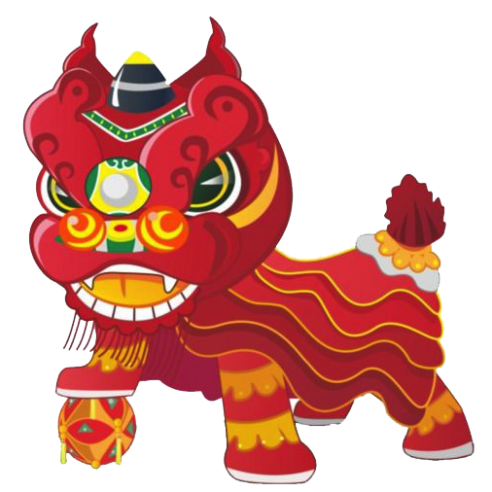
CORRECT
Next

Slide 114
Instruction:
Click on the right word for each picture.
Start

Slide 115
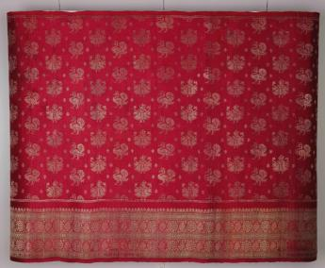
Click on the right word for the picture.
Sari
Veshti
Collection of Indian Heritage Centre
Shirt

Slide 116
CORRECT
Collection of Indian Heritage Centre
Sari
Next

Slide 117
Try Again

Slide 118
Try Again

Slide 119
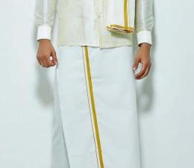
Click on the right word for the picture.
Sari
Pants
Veshti

Slide 120
CORRECT
Veshti
Next

Slide 121
Try Again

Slide 122
Try Again

Slide 123
Instruction:
Read each statement and decide if it is True or False.
Start

Slide 124
Question 1
A sari is a long piece of rectangular cloth
worn by women.
True
False

Slide 125
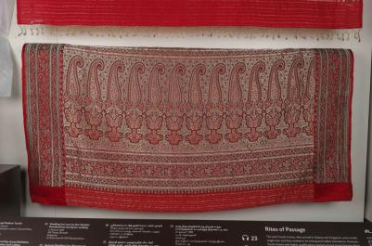
True
Collection of Indian Heritage Centre
Next

Slide 126
Try Again

Slide 127
Question 2
All saris come in only one colour
and pattern.
True
False

Slide 128
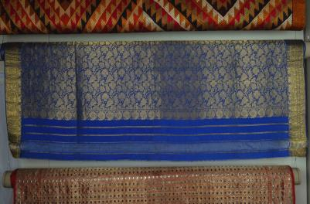
False
Collection of Indian Heritage Centre
Collection of Indian Heritage Centre
Next

Slide 129
Try Again

Slide 130
Question 3
The men usually wear a veshti during
Indian festivals.
True
False

Slide 131
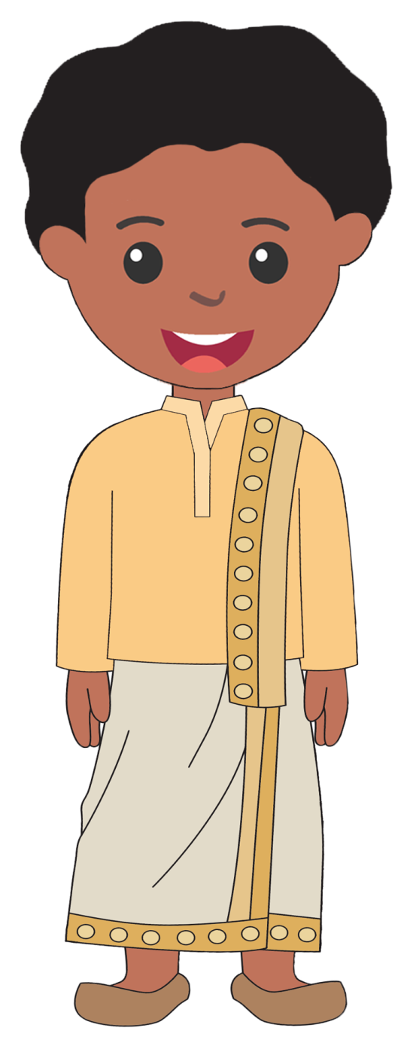
True
Next

Slide 132
Try Again

Slide 133
Question 4
A veshti is also called dhoti.
True
False

Slide 134
True
Next

Slide 135
Try Again

Slide 136
Instruction:
Count and click on the correct number of
oil lamps in the picture.
Start

Slide 137
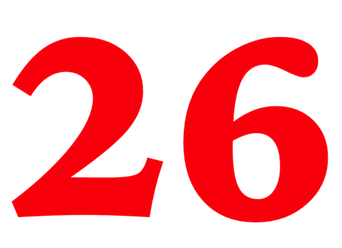
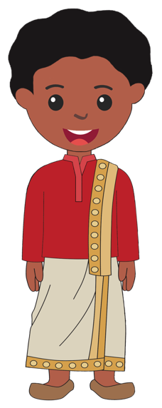
How many oil lamps do you see in the picture?

Slide 138
CORRECT
Next

Slide 139
Try Again

Slide 140
Try Again

Slide 141
Thank you for joining me at the
Indian Heritage Centre.
I hope that you have enjoyed yourself and learnt something new.
Let’s review what we have learnt!
BACK
NEXT

Slide 142
Sari
Collection of Indian Heritage Centre
Collection of Indian Heritage Centre
BACK
NEXT

Slide 143
Veshti
BACK
NEXT

Slide 144
Oil Lamps (Diyas)
Rangoli
Mithai
Murukku
Vadai
Deepavali
BACK
NEXT

Slide 145
See you again at our upcoming
exciting adventure at
the Asian Civilisations Museum.
BACK
NEXT

Slide 146
Visit indianheritage.org.sg to learn more about
the Indian Heritage Centre.
For more children’s activities
offered by the Indian Heritage Centre,
visit our Facebook page at
http://www.facebook.com/indianheritagecentre/
BACK
NEXT

Slide 147
Brought to you by
Play Again
This resource is designed in conjunction with the Singapore’s Little Treasures programme and has been adopted for home or classroom- based learning. Copyrighted by the National Heritage Board. No part of this design may be reproduced, stored in a retrieval system, or transmitted in any form or by any means, electronic, mechanical, photocopying, recording or otherwise for profit without permission of the copyright owner.

